Slide 1
Mastering
Java Streams API
Source → steps → result, in plain Java 25
EhB · Jente Sondervorst
Notes:
Welcome. Who am I, and what will we do in the next 3 hours: understand, create, transform and finish streams, see what goes wrong, then practise.

Slide 2







What we will do today
Introduction
Terminal operations
tools, IDE suggestions, the domain
collect, count, reduce, Optional
What is a Stream
Pitfalls
source, steps, result
code that is broken on purpose
Stream Initialization
Exercises
creating streams
practice makes perfect
Intermediate operations
filter, map, flatMap … + debugging
Notes:
Walk through the agenda. Stress that 'Streams explained' has four parts and that debugging streams is part of it. Pitfalls and exercises come last.

Slide 3
Introduction
01
Tools, IDE suggestions and the domain we will use all day

Slide 4




How this course works
Theory lessons
Output tasks
Exercises
Pitfalls
Open src/Main.java, read it top to bottom and run it.
Finish the TODO. Your output must match the expected output.
Implement the method. The unit tests tell you when you are done.
This code is broken on purpose. Run it and watch what goes wrong.
Tools
Java 25 (LTS) · Gradle wrapper (./gradlew) · IntelliJ IDEA + Learn and Teach · JUnit + AssertJ
sdkman and a good terminal (iTerm2, Windows Terminal) are optional but handy
Notes:
Explain the four kinds of tasks. Theory: read and run Main. Output tasks: match expected output. Exercises: tests. Pitfalls: broken on purpose, so we watch them, we do not fix them.

Slide 5
Functional interfaces: the vocabulary of streams
Interface | Method | Meaning | Example
Predicate<T> | boolean test(T) | yes or no about a value | s -> s.isEmpty()
Function<T,R> | R apply(T) | turns a value into another | String::length
Consumer<T> | void accept(T) | does something, returns nothing | System.out::println
Supplier<T> | T get() | produces a value from nothing | ArrayList::new
BinaryOperator<T> | T apply(T, T) | combines two values of one type | (a, b) -> a + b
Comparator<T> | int compare(T, T) | orders two values | comparingInt(String::length)
filter takes a Predicate, map a Function, forEach a Consumer, sorted a Comparator.
Notes:
One abstract method each, so a lambda or method reference can implement them. Streams are built from these: filter takes a Predicate, map a Function, forEach a Consumer, collect uses Supplier and BinaryOperator internally, sorted a Comparator.

Slide 6
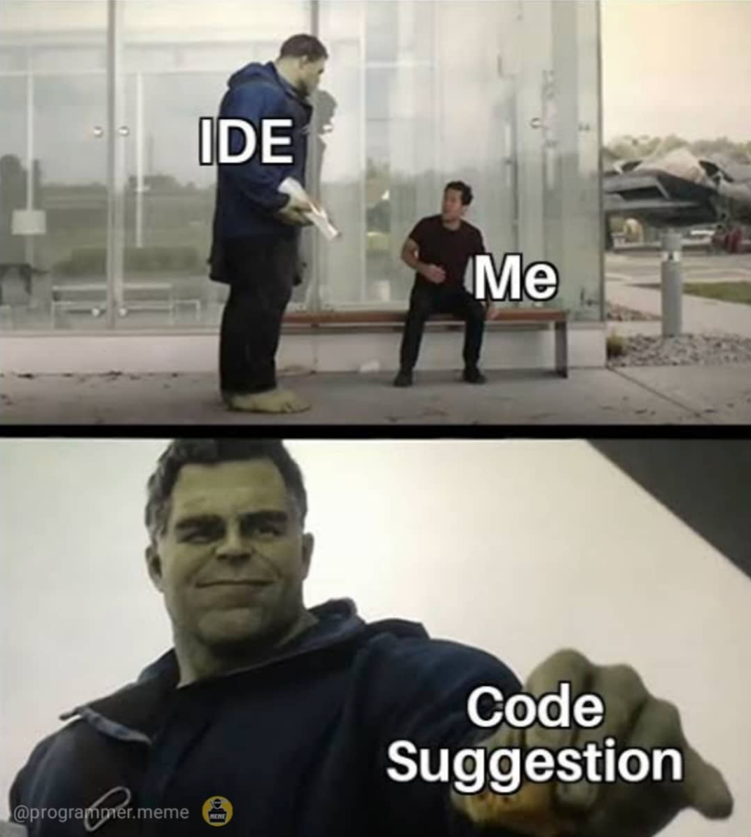
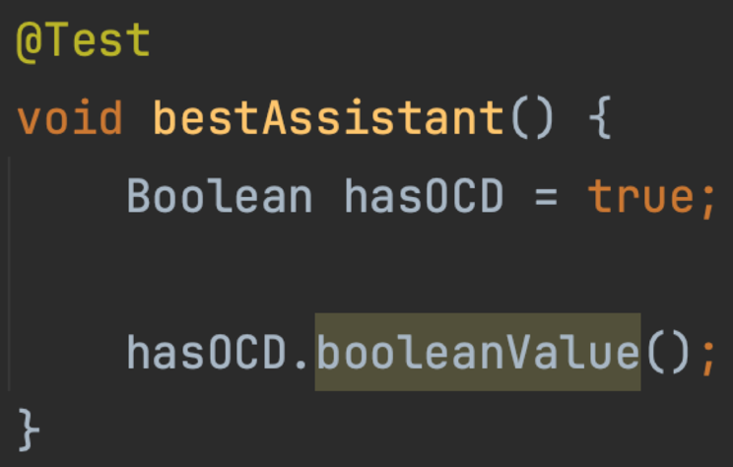
IntelliJ suggestions are part of the lesson
Some snippets are intentionally suboptimal
Yellow or grey highlight in the editor? Press Alt+Enter
Apply the suggestion, then compare before and after
Example: Collectors.toList() → .toList(), lambda → method reference
When you see this, you must apply it
Notes:
Some code is intentionally suboptimal so that IntelliJ suggests an improvement. When you see the yellow or grey highlight, press Alt+Enter and compare before and after. Hulk meme: when you see the suggestion, you must realise you have to apply it.

Slide 7
The domain: four records
Customer
Order
customerId
id · name · lastName
id · customerId · paid · orderLines
orderLines
References are plain ids, not objects: to get from an id to the Article or Customer you look it up.
OrderLine
Article
articleId
articleId · quantity · price
total() = price × quantity
id · name
Notes:
All domain classes are records. References are plain ids, not objects: to go from an id to the object you need a lookup. OrderLine.total() is price times quantity.

Slide 8

The sample data
10
articles
Coffee, Pizza, Candy, Taco …
5
orders
3 paid, 2 unpaid
18
order lines
worth EUR 39.00 in total
Green phone = paid order, red phone = unpaid order, icons = order lines.
Notes:
Same data in (almost) every lesson. Customers only appear in the exercises. Green phone is a paid order, red phone an unpaid order, the icons are the order lines.

Slide 9
What is a Stream
02
A pipeline: source, steps, result

Slide 10
My first Stream: from loop to pipeline
for loop
stream
double sum = 0;
for (OrderLine l : Database.orderLines) {
sum += l.total();
}
double sum = Database.orderLines
.stream()
.mapToDouble(OrderLine::total)
.sum();
Both print: The sum of all the order lines prices is: EUR39.00
Read it top to bottom: the stream gets smaller or changes shape at every step.
Notes:
Task 1. Sum the total of every order line. The loop and the stream give the same answer: EUR39.00. Ask the room which one they find easier to read.

Slide 11


Anatomy of a pipeline
Source
Intermediate operations
Terminal operation
Where the elements come from
Zero or more steps that transform the stream
Exactly one. Produces the result and starts the pipeline
orderLines.stream()
mapToDouble(…)
sum()
double sum = Database.orderLines.stream() // source
.mapToDouble(OrderLine::total) // intermediate
.sum(); // terminal
Notes:
Three parts. The source says where the elements come from. Zero or more intermediate operations transform. Exactly one terminal operation produces the result and starts the pipeline.

Slide 12
My first Stream: warehouse replenishment
orders.stream()
.filter(Order::paid)
.flatMap(o -> o.orderLines().stream())
.collect(groupingBy(OrderLine::articleId,
summingInt(OrderLine::quantity)));
if (order.paid())
→
filter
inner loop over order lines
→
flatMap
Map accumulator
→
a collector
Example — Order 1 (paid): 2 Pizza + 1 Candy · Order 2 (paid): 1 Pizza + 1 Beer · Order 3 (unpaid): 5 Coffee
Delivery: 3 Pizza, 1 Candy, 1 Beer
Notes:
Task 2 goes beyond what they have seen so far, so this is the moment to let an AI assistant help. Paid orders are replenished with the same quantity of each article; unpaid orders are ignored. Quantities per article are added up. Map each part of the loop to a stream step.

Slide 13
Stream Initialization
03
A stream always starts from a source

Slide 14
Ways to create a stream
collection.stream()
Stream.of(a, b, c)
Stream.concat(s1, s2)
from any collection, also an empty one
from values
two streams become one
Stream.builder()
IntStream.range(a, b)
LongStream.range(a, b)
add elements one by one, then build
number range; also rangeClosed
same for long; also rangeClosed
Also good to know
Stream.empty() · Arrays.stream(array) · "text".chars() · map.entrySet().stream() · Files.lines(path)
Notes:
The demos in Main: collection.stream() (also for an empty list), Stream.of, Stream.concat, Stream.builder, IntStream range/rangeClosed, LongStream range/rangeClosed. One demo fails on purpose; we find out why together.

Slide 15

Ranges, infinite streams and empty sources
range vs rangeClosed
Empty and null
IntStream.range(1, 5) // 1 2 3 4
IntStream.rangeClosed(1, 5) // 1 2 3 4 5
An empty list gives an empty stream: fine
A null source throws NullPointerException
Infinite sources: always combine with a limit
Stream.generate(supplier) and Stream.iterate(seed, next) never end.
The finite, for-like variant:
Stream.iterate(seed, hasNext, next)
Notes:
range excludes the end value, rangeClosed includes it. generate and iterate are infinite: always combine them with limit, or use the three-argument iterate, which is finite. An empty source is fine; a null source throws a NullPointerException.

Slide 16
Stream Intermediate operations
04
Transform and select, lazily

Slide 17

The four core operations
Operation | Elements | Type | Example
filter | fewer | same | keep the paid orders
map | same number | new | order → its total
flatMap | one-to-many, merged | new | order → its order lines
distinct | fewer | same | drop duplicates
Returns a new stream, so you can chain.
Nothing runs until a terminal operation is called.
Notes:
An intermediate operation returns a new stream, so you can chain them. Nothing runs until a terminal operation is called. filter: fewer elements, same type. map: same number, new type. flatMap: one-to-many, merged into one stream, e.g. order to its order lines. distinct: drops duplicates, its position in the chain changes how much work follows.

Slide 18
More operations to know
skip(n)
limit(n)
takeWhile(p)
drops the first n elements
keeps at most n; makes an infinite stream finite
keeps until the condition first fails, then stops
dropWhile(p)
sorted()
peek(action)
drops until the condition first fails, keeps the rest
new order; needs to see all elements first
runs an action on the way past; debugging only
mapToInt
mapToDouble
mapToLong
→ IntStream, same count
→ DoubleStream, same count
→ LongStream, same count
Notes:
Not demoed in Main but you will meet them: skip, limit, takeWhile, dropWhile, sorted, peek and the primitive mapTo variants.

Slide 19
One step, four shapes
Statement lambda
Expression lambda
.filter(order -> {
return order.paid();
})
.filter(order -> order.paid())
Method reference
Method
.filter(Order::paid)
.filter(this::isPaid)
Same result in all four. The shorter the form, the easier to read.
Notes:
The first four demos in Main do the same work with a different kind of step: statement lambda, expression lambda, method reference, method. Introduce IntelliJ's suggestions here: it will propose the shorter form.

Slide 20

Lazy: elements flow one at a time
filter
map
terminal
peek
element 1 → all stages, then element 2 → all stages …
Looks at each element without changing the stream.
For debugging only. Not for production code, and never with an action that changes state.
No terminal operation? Nothing runs.
Each element passes all stages before the next one starts
A failing map surfaces at the terminal operation
Order matters: it changes the result and the amount of work
Notes:
A stream is lazy. Elements flow one at a time through all stages, which is why peek output is interleaved with later stages. A failure shows up at the terminal operation, not at the line where the faulty map or filter was written. The order of steps changes the result and the amount of work.

Slide 21


Debugging streams: four tools
1 peek
2 Lambda breakpoint
Quick, but you edit the code. Elements appear one at a time, interleaved with later stages. Remove it again.
Click the gutter next to the lambda and Debug. Hit once per element; inspect order in Variables.
3 Trace Current Stream Chain
4 Read the stack trace
In Debug: More → Trace Current Stream Chain. One tab per stage, plus Flat Mode. See where an element disappeared.
Ignore the java.util.stream frames. Find the first frame in your code. The failure happens at the terminal operation.
Rule of thumb: peek for a quick look · lambda breakpoint for one element · Trace Current Stream Chain for the whole chain
Notes:
The presenter walks through these on the demos in Main. Nothing new to write. Rule of thumb: peek for a quick look, a lambda breakpoint to inspect one element, Trace Current Stream Chain to see the whole chain.

Slide 22
Stream Terminal operations
05
Finish the pipeline and start it

Slide 23
Terminal operations in the demo
Operation | What it does
collect(Collectors.toList()) / toSet() | Collect into a List or a Set (duplicates disappear, no order)
toUnmodifiableList() / toUnmodifiableSet() | Collect into a collection that cannot be changed afterwards
collect(Collectors.joining("|")) | Glue the elements (Strings) into one String
count() | Number of elements left in the stream
mapToDouble(...).sum() / average() / max() / min() | Totals on a primitive stream; the last three return an optional
summingDouble(...) / averagingDouble(...) | The same totals, as a Collector
max(Comparator) / min(Comparator) | Largest or smallest element, e.g. comparingDouble
findFirst() | First element, and stops the stream there
Money as double? Fine for a demo. In real code use BigDecimal: 0.1 cannot be represented exactly.
Notes:
Walk through the table in the order Main calls them. The sets are sorted before printing: a Set has no guaranteed order. Prices are double to keep the code short; in real code use BigDecimal.

Slide 24
Three ways to get a List
Call | Result list | null elements | Typical use
collect(Collectors.toList()) | ArrayList in practice, not guaranteed | allowed | legacy code
.toList() (Java 16+) | unmodifiable: add throws | allowed | default choice
collect(Collectors.toUnmodifiableList()) | unmodifiable | rejected (NPE) | no nulls allowed
Accepting IntelliJ's suggestion can break code that calls add on the result of collect(Collectors.toList()).
Notes:
IntelliJ suggests replacing collect(Collectors.toList()) with toList(). Fine, but not identical: toList() is unmodifiable. Code that calls add on the result breaks when you accept the suggestion, as collectingIntoCollection does.

Slide 25
Collectors: grouping
Collector | What it does | Result on the course data
groupingBy(key) | Map<key, List<…>> | customer id → list of their orders
groupingBy(key, counting()) | group and count each group | {1=2, 2=2, 3=1}
groupingBy(key, summingDouble(…)) | group and sum a value per group | {1=20.5, 2=13.0, 3=5.5}
groupingBy(key, mapping(f, toList())) | group and transform each element | {1=[1, 2], 2=[3, 4], 3=[5]}
orders.stream().collect(
groupingBy(Order::customerId, summingDouble(Order::total))); // {1=20.5, 2=13.0, 3=5.5}
Notes:
collect can do much more than build a list. Results were produced by running each snippet on the course data (5 orders, 18 order lines). groupingBy makes a Map of key to list; add a downstream collector to count, sum or transform each group.

Slide 26
Collectors: more
Collector | What it does | Result on the course data
partitioningBy(Order::paid, counting()) | exactly two groups: false and true | {false=2, true=3}
toMap(key, value, Integer::sum) | build a Map; merge function for duplicate keys | quantity per article id
summarizingDouble(OrderLine::total) | count, sum, min, average, max in one pass | count=18, sum=39.0, …
teeing(c1, c2, merger) | two collectors over one stream, combined | 5 orders, 39.0
toMap without a merge function throws IllegalStateException on a duplicate key:
Duplicate key 1 (attempted merging values 1 and 1)
Notes:
partitioningBy always has exactly two keys. toMap throws IllegalStateException on a duplicate key unless you pass a merge function; on the course data that happens for article 1. summarizingDouble gives count, sum, min, average and max in one pass. teeing runs two collectors over one stream.

Slide 27
Yes/no questions, sorting and reduce
anyMatch
allMatch
noneMatch
orderLines.stream()
.sorted(comparingDouble(OrderLine::total)
.reversed()
.thenComparing(OrderLine::articleId))
at least one?
all of them?
none of them?
stops at first hit
stops at first miss
stops at first miss
empty: false
empty: true
empty: true
double total = orderLines.stream()
.map(OrderLine::total)
.reduce(0.0, Double::sum); // 39.0
reduce is the general fold. Prefer mapToDouble(…).sum(): shorter, and no boxing.
Prefer
findFirst() over findAny().
Identity must be neutral (0.0 for a sum).
Notes:
anyMatch stops at the first hit, allMatch and noneMatch at the first miss. On an empty stream they give false, true and true: all of nothing is vacuously true. Prefer findFirst over findAny. reduce is the general fold, but sum() is usually better.

Slide 28
Optional: decide what nothing means
Call | Present | Empty
orElse(-1) | the value | -1 (argument always evaluated)
orElseGet(() -> -1) | the value | -1 (supplier only runs when empty)
orElseThrow(() -> new …) | the value | throws your exception
orElseThrow() | the value | NoSuchElementException
ifPresent(consumer) | runs the consumer | does nothing
map(f) | Optional of the result | stays empty
orElse(null) is a smell: it turns the explicit “maybe” back into a null. Choose a default, orElseThrow, or keep mapping.
Notes:
min, max, findFirst, findAny, average and reduce(accumulator) return an Optional because the stream may be empty. orElse(null) is a smell: it turns the explicit maybe back into a null that the next reader may forget to check.

Slide 29
What is new since Java 8
Feature | Since | What it does
Stream.toList() | 16 | shortcut for a list: unmodifiable, null allowed
Stream.ofNullable(x) | 9 | one element, or empty when x is null
iterate(seed, hasNext, next) | 9 | a finite, for-like stream
takeWhile / dropWhile | 9 | keep or skip a prefix while a condition holds
Collectors.teeing | 12 | two collectors over one pass
mapMulti | 16 | zero, one or many elements downstream, without a temporary stream
Unnamed parameter _ | 22 | name for a parameter you do not use
Gatherers | 24 | custom intermediate operations
Notes:
The course code is written in Java 8 style on purpose, because that is what IntelliJ's suggestions start from, but the baseline is Java 25. Reference only, nothing to run. None of these needs a preview flag on JDK 25.

Slide 30
Gatherers: custom intermediate operations
Gatherer | What it does | Result
windowFixed(3) | consecutive lists of 3 | [[Apple, Beer, Candy], [Chicken, …]]
windowSliding(2) | overlapping windows | [[Apple, Beer], [Beer, Candy], …]
scan(init, f) | running result after each element | [1, 3, 6, 10]
fold(init, f) | like reduce, emits one element | [10]
orders.stream()
.map(Order::total)
.gather(Gatherers.scan(() -> 0.0, Double::sum))
.toList();
// [6.7, 20.5, 27.1, 33.5, 39.0] running revenue
The last value is the 39.0 that sum() returns.
Notes:
Gatherers are final since Java 24 (preview in 22 and 23). A collector can only end a pipeline; a gatherer is an intermediate operation so the stream continues. They are the way to write operations that look at more than one element at a time: windows, running totals.

Slide 31
Pitfalls
06
Broken on purpose. Do not fix it, watch it.

Slide 32

Pitfall: endless streams
// 1: no short-circuiting operation
IntStream.iterate(0, i -> 1 - i) // 0 1 0 1 …
.forEach(System.out::println);
// 2: looks safe, still hangs
IntStream.iterate(0, i -> 1 - i)
.distinct()
.limit(10) // waits for 10 elements
.forEach(System.out::println);
Why
distinct() only ever lets 0 and 1 through, so limit(10) waits for elements that never arrive.
Fix
limit(10) before distinct(), or give the stream an end: iterate(0, i -> i < 10, i -> i + 1)
Notes:
Press Stop in IntelliJ when you have seen enough: the program does not stop by itself. Only a short-circuiting operation (limit, findFirst, takeWhile, anyMatch) can end an infinite stream. distinct before limit(10) on a stream with only two distinct values never reaches ten elements. The timeout only stops waiting for the task, the pipeline keeps running.

Slide 33
Pitfall: the order of operations matters
limit(10).skip(5) → 5 6 7 8 9 (only five numbers)
0
1
2
3
4
5
6
7
8
9
10
11
12
13
14
skip(5).limit(10) → 5 6 7 … 14 (ten numbers)
0
1
2
3
4
5
6
7
8
9
10
11
12
13
14
dropped by skip
printed
never produced (cut by limit)
Each step only sees what the previous step passes on.
Notes:
Before running, guess how many numbers it prints. limit(10).skip(5): take the first 10 (0 to 9), then drop 5: five numbers. skip(5).limit(10): drop 5, then take 10: five to fourteen. Each step only sees what the previous step passes on.

Slide 34
Pitfall: a slow call inside a loop or stream
The N+1 problem
1 call for the lines + N calls for the details: 18 calls per run at 100 ms each. The loop is not the problem, the call is. A stream just hides it inside a lambda.
Fix: fetch once, then work in memory
Map<Integer, Article> articles =
Database.getArticles();
articles.get(line.articleId())
Notes:
This is the N+1 problem: one call to get the lines plus N calls to get the details. Database.getArticle(id) pretends to be a remote call of 100 ms; there are 18 order lines, so 18 calls per run. The bulk variants make one call (300 ms) and look articles up in a Map. A for loop and a stream behave the same here; the stream can hide the call inside a lambda. Timings measured on JDK 25, Apple silicon, 10 runs each; absolute numbers vary per machine, the ratio (about 6x) does not.

Slide 35
Exercises
07
Practice makes perfect: make the tests green

Slide 36

Three exercises, three skills
Exercise 1
Exercise 2
Exercise 3
Filter customers
Names in one list
Unique article names in unpaid orders
Last name contains e; and first name contains l; or any field contains o. Case-insensitive.
All customers as “firstname lastname” and all articles by name, in one list of 44 strings.
Filter unpaid orders, flatten their lines, look up each article name by id.
filter · && / || · toLowerCase
map · Stream.concat
filter · flatMap · map · distinct
Notes:
Run CourseTests. Exercise 1: filter customers, case-insensitive. Exercise 2: names in one list, 44 entries (34 customers plus 10 articles). Exercise 3: unique article names in unpaid orders: Chicken, Ice Cream, Coffee and Taco.

Slide 37




Key takeaways
A pipeline has three parts
Nothing runs without a terminal operation
source, zero or more intermediate steps, exactly one terminal operation
elements flow one at a time through all stages
Order changes the result
Pick the right collector
and the amount of work: filter early, limit before distinct
groupingBy, partitioningBy, toMap with a merge function
An Optional says “maybe nothing”
Fetch in bulk, then stream
choose a default, throw, or keep mapping; avoid orElse(null)
never call a slow service per element
Questions?
Notes:
Summarise. Source, steps, result. Nothing runs without a terminal operation. Order matters. Apply IntelliJ's suggestions. Then: questions, and on to the exercises.

